Slide 1
Rockbuster Stealth
Customer Reward Presentation

Slide 2
Agenda
Introduction
Identifying
Summary
Conclusions & Recommendations

Slide 3
Introduction
Rockbuster Stealth is declaring bankruptcy and going out of business due to stiff competition from streaming services such as Netflix and Amazon Prime. The Rockbuster Stealth management team wants to reward their most contributive and loyal customers and regions. This presentation aims at identifying those factors.

Slide 4
Primary Identification Goals
Top 10 Countries
Top 10 Cities
Top 5 Customers

Slide 5
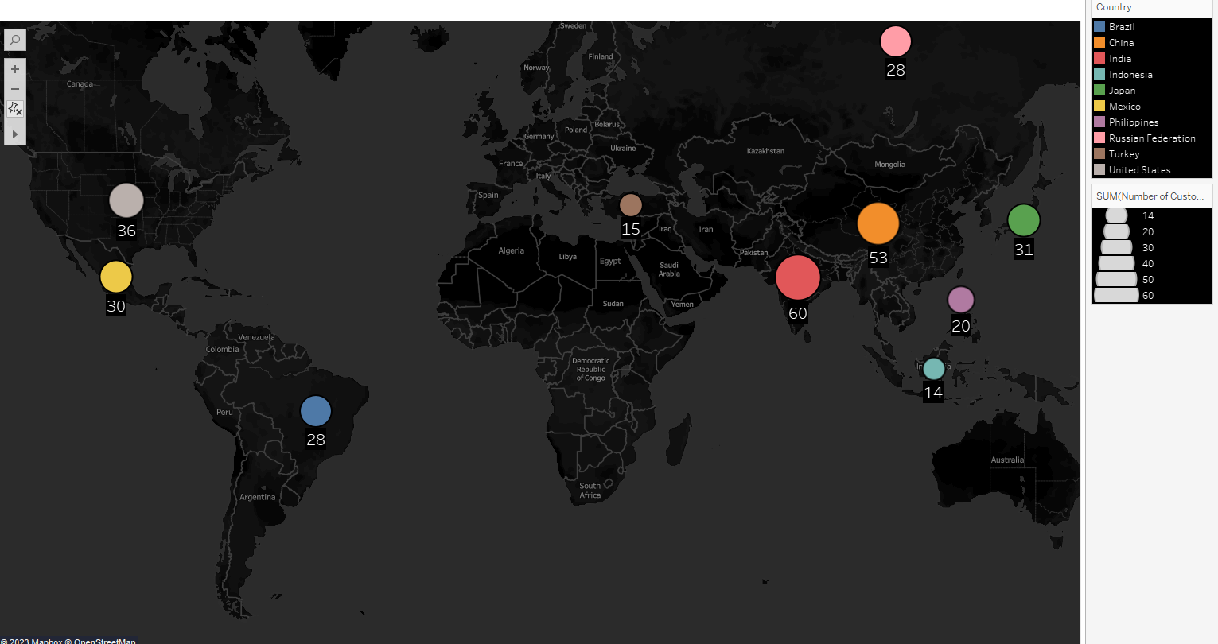
Top 10 Countries For Rockbuster Stealth Customer Count

Slide 6
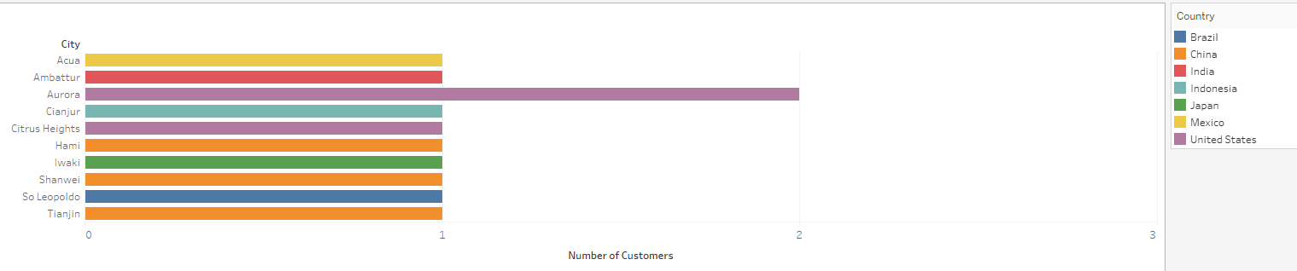
Top 10 Cities for Rockbuster Stealth Customer Count

Slide 7
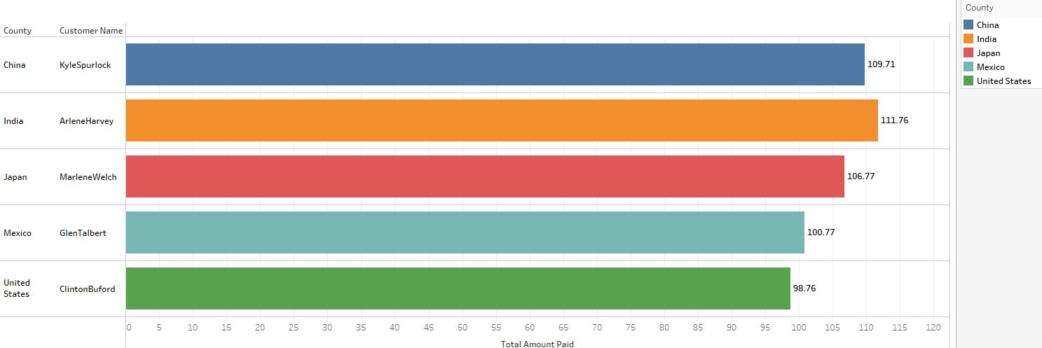
Top 5 Customers in Total Monetary Contribution

Slide 8
A Summary of Rockbuster Stealth Data
Minimum Rental Duration: 3 days
Maximum Rental Duration 7 days
Average Rental Duration 5 days
Minimum Value of Rentals: 9.99$
Maximum Value of Rentals: 29.99$
1000 Total Rentals in Collection
Average length of rentals: 115 minutes
Total Active Customers: 584

Slide 9
Conclusions & Recommendations
Results
Recommendations
India and China lead the way in terms of total customers.
Our query into top 10 cities identifies Aurora as an outlier.
China and US have more results than other countries in top 10 cities.
India, China, and US are all represented in our top 5 customers.
Prioritize rewarding the identified top 5 customers.
Subsequent reward programs should be targeted towards India -> China -> US, as they are the most saturated with customers and customer spending.

Slide 10
Thank you
Jonathan Owens
jmowens33@outlook.com
https://public.tableau.com/app/profile/jonathan.owens7260/viz/RockbusterCharts/CountryCustomerCount?publish=yes

